Slide 1
150,000 and still going: Online training on play-based learning (P.L.A.Y.) What the research tells us
Khulisa Management Services
ECD Knowledge Building Seminar, 21/11/2019

Slide 2
Powerful Learning Around You (P.L.A.Y) is a FREE online in-service training course that complements existing and formal training
Qualifies participants for the 15 Continuous Professional Development points with the South African Council for Educators (SACE)
Goal: train 150,000 ECD practitioners, caregivers (including parents) and Grade R to 3 educators by end of 2018 to strengthen skills and knowledge to implement play-based learning
Implemented by Cotlands, in partnership with UNICEF, DBE and LEGO Foundation

Slide 3
UNICEF commissioned Khulisa Management Services (Pty) Ltd to conduct action research on the P.L.A.Y. training course from 2016 to 2019

Slide 4
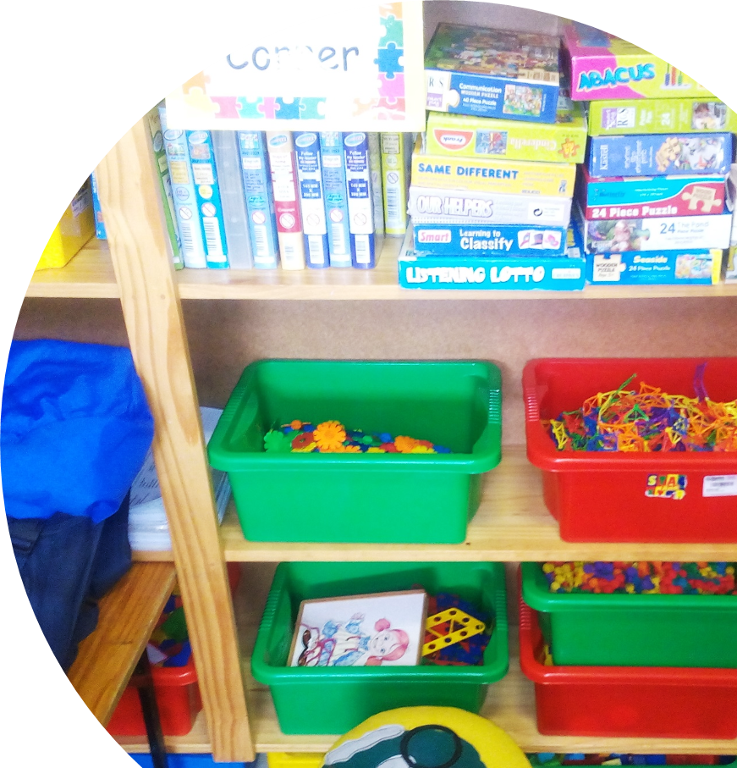
Objectives
Assist Cotlands, UNICEF & DBE to demonstrate the P.L.A.Y. training is achieving goals
Derive lessons learned from the programme to improve P.L.A.Y. training implementation

Slide 5
Methodology
Khulisa used the following data collection methods for the action research
Observations (Classroom & School Functionality Assessment)
Interviews (Educators & Principals)
Perceptions of Play (ECD officials, educators, principals)
Desk Review
Satisfaction Survey (P.L.A.Y. participants)

Slide 6
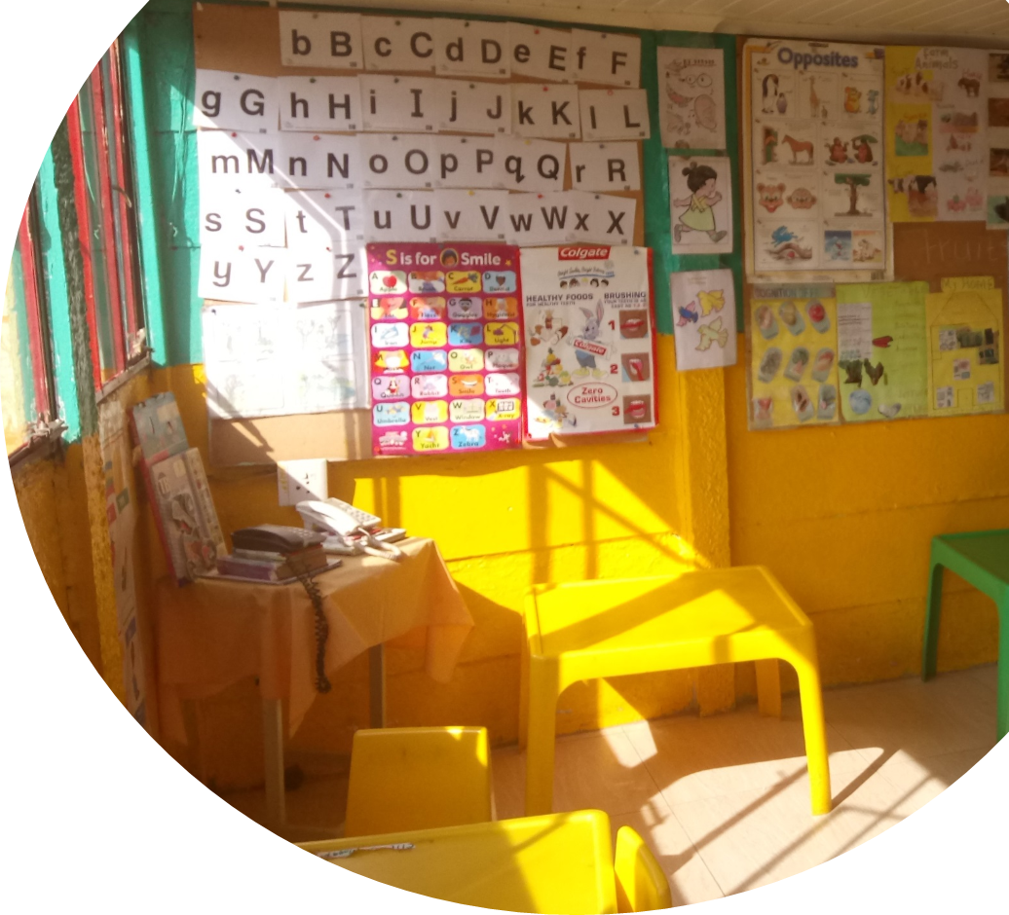
Uthando Daycare Centre
Data Collection

Slide 7
Fieldwork
Baseline 2017
3 Action Research Data collection rounds 2017 - 2018

Slide 8
Schools/ECD centres visited
593
(220 schools and 373 ECD centres)

Slide 9
392
Classrooms observed

Slide 10
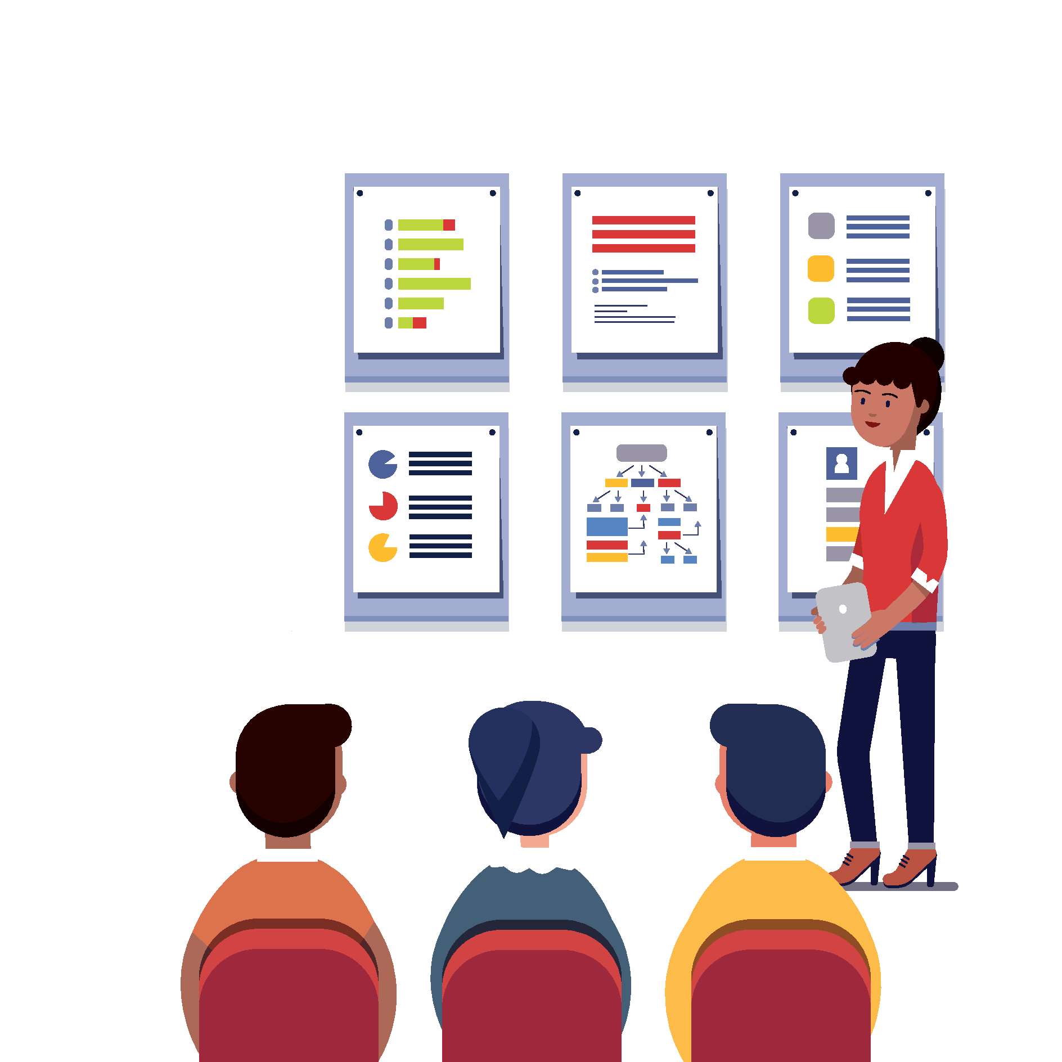
Findings

Slide 11
The state of play in South Africa before P.L.A.Y

Slide 12
Positive and exciting policy environment for play-based learning. But:
63%
of schools/ECD centres had environments that were somewhat conducive to play based learning
1/3
of schools/ECD centres had an environment that was either poor (29%) or inadequate (8%) for play-based learning

Slide 13
Educators had positive attitudes towards, but many lacked knowledge, skills or ability to engage children in play

Slide 14
Key Findings after P.L.A.Y implementation

Slide 15
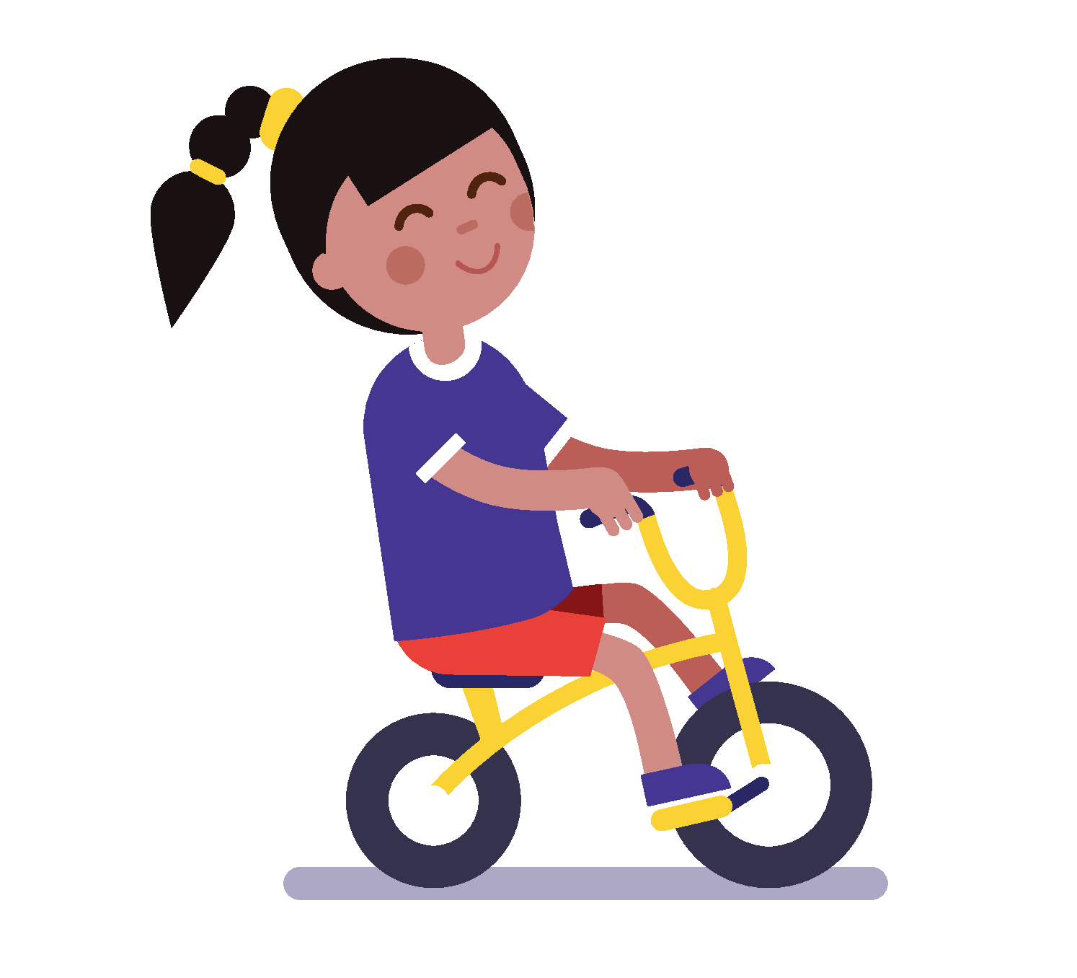
Educators/practitioners are excited to engage in online training: they liked the style, local content and recommended training to others

Slide 16
P.L.A.Y contributed to continuous professional development for educators/practitioners
2 out of 3
3 out of 5
Had not attended any other training on play based learning
did not have tertiary education
Data from 526 Participants. Source: Fieldwork

Slide 17
Educators stated that they registered for P.L.A.Y to gain new knowledge and skills and improve their teaching practices

Slide 18
Participants reported having an excellent understanding of play-based learning after completing the course, compared before attending the course
260
142
53%
29%
67
26
495 Responses
14%
5%
BEFORE | I did not understand | I had some understanding | I had a good understanding | I had an excellent understanding
AFTER | I do not understand | I have some understanding | I have a good understanding | I have an excellent understanding
493 Responses
5
24
1%
5%
177
287
34%
58%
Source: Teacher Interviews. Fieldwork

Slide 19
88%
Of educators mentioned changing a teaching practice
“Much more interaction with the children, meaning sitting down with them on the floor.”
“I used to teach children by just talking to them but as a result of P.L.A.Y, I have now introduced practical [activities] like using building blocks.”
P.L.A.Y. participants
449 participants. Source: Teacher Interviews

Slide 20
“I have ensured that I make the classroom conducive for play based learning by allocating different corners for different play activities.”
“Giving them room to play and express themselves”
“I now use pictures on the wall for teaching. I did not have pictures before training”

Slide 21
Perceptions of Play
Many, but not all, educators, principals, and ECD officials are positive about learning through play, in line with policy
Source: Teacher and Principal Perception Surveys

Slide 22
Children learn through
free play
Learning should be learner-centred rather than teacher directed
70% of practitioners, educators and principals surveyed believe a learner-centred approach is central to teaching
61%
free play leads to some learning in children
39%
39% of practitioners, educators and principals believe that children do not learn anything during free play
30% still believe learning should only be teacher directed

Slide 23
Challenges hinder the effective use of play-based learning
Low or insufficient levels of engagement with the P.L.A.Y. training
Lack of a supportive management
No opportunity to practice their new skills
Notes:
Challenges include: insufficient space, equipment, resources, etc.

Slide 24
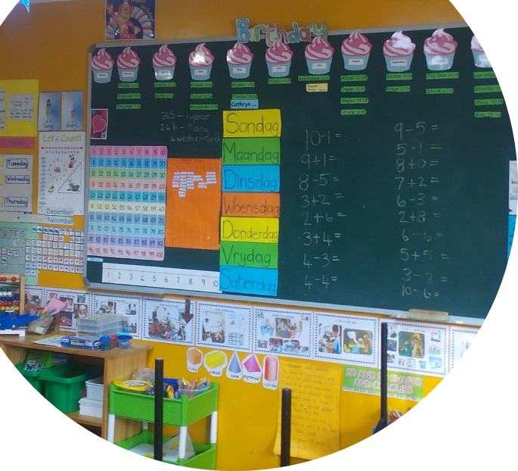
Not easy to measure if the P.L.A.Y training is effective in enhancing teaching practice
Translation of knowledge gained through the training into teaching practice could not be verified
Training is self-paced meaning different levels of engagement with the training content

Slide 25
Challenges that limit training accessibility
Limited access to internet and IT skills
High data costs
Training offered in English
Videos sometimes difficult to play

Slide 26
Despite access challenges, numerous participants completed P.L.A.Y. For many, it was their first online training experience, leading to more digital inclusion

Slide 27
169,819 P.L.A.Y course registrations
130,941 P.L.A.Y courses were completed between inception in 2016 and February 2019 providing an overall completion rate of 77%
But play-based learning needs support
Course registration and completed data comes from the Cotlands report dated 1 February 2019; submitted to Khulisa on 8 February 2019 by UNICEF.

Slide 28
Conclusions

Slide 29
P.L.A.Y. has potential to contribute to teachers’ professional development and life-long learning
There is a positive policy environment for play-based learning in South Africa
There is a clear demand for the P.L.A.Y. training
The main training benefit is increasing awareness of play-based learning for teachers, practitioners, parents, caregivers, etc.

Slide 30
Educators are excited about the training methodology and local P.L.A.Y. content, but challenges limit uptake and ability to translate their learning into changed practice

Slide 31
There is need to invest in human, infrastructure and play-focussed resources - in line with DBE policies, norms and standards
Educators must be supported, mentored and encouraged by principals to transition the learning into classroom practice

Slide 32
Join the online community and have fun!
https://playsa.org/
Powerful Learning Around You (P.L.A.Y) is a FREE online in-service training course that complements existing and formal training

Slide 33
Thank You! Questions?
Jennifer Bisgard
+27 11 447 6464
jbisgard@khulisa.com
26 Seventh Avenue, Parktown North, Johannesburg
www.khulisa.com

